Slide 1
IMAGE BASED BREED RECOGNITION FOR CATTLE AND BUFFALO OF INDIA
CSE7302- UNIVERSITY PROJECT
Review-1
Batch Number: CSE_161
Under the Supervision of,
Dr. Md Zia Ur Rahman
Assistant Professor At,
School of Computer Science and Engineering
Presidency University
Roll Number | Student Name
20221CSE0388 | Sakshi Kumari
20221CSE0066 | Shreyas S
Name of the Program: B. Tech (CSE)
Name of the HoD: Dr. Blessed Prince
Name of the Program Project Coordinator: Mr. Muthuraju
Name of the School Project Coordinators: Dr. Sampath A K , Dr. Geetha A

Slide 2
Problem Statement Number: SIH25004
Organization: Ministry of Agriculture & Farmers Welfare
Category: Software
Problem Description:
Identification of cattle and buffalo breeds is crucial for livestock management, breeding programs, veterinary care, and subsidy allocation. Manual breed identification is error-prone, time-consuming, and requires expert knowledge. This project proposes an AI-based image recognition system to automatically classify Indian cattle and buffalo breeds using deep learning techniques.

Slide 3
Content
Problem Statement
Objectives
Background and Related work for title Selection
Analysis of Problem Statement
Innovation or Novel Contributions
Git-hub Link
Timeline of the Project
References

Slide 4
Problem Statement Objectives
To develop an automated system for breed recognition of cattle and buffalo
To classify multiple Indian indigenous breeds using image data
To compare CNN and Transformer-based models for accuracy
To improve identification accuracy under real-world conditions
To support farmers and veterinarians with a fast decision-support tool

Slide 5
Background & Related Work
Background:
India possesses the largest livestock population globally, with more than 30 recognized cattle and buffalo breeds. Traditional identification relies on physical traits such as horn shape, hump, coat color, and body structure, which is subjective and inconsistent.
Related Work:
Recent studies have applied Convolutional Neural Networks (CNNs) and Vision Transformers (ViTs) for animal classification tasks. However, most existing work focuses on limited cow breeds and ignores buffalo breeds, lacks explainability, or uses small datasets.

Slide 6
Reason for Title Selection
Reason for Selecting the Title:
Addresses a real agricultural and economic problem
Limited existing research on combined cattle and buffalo breed recognition
Strong alignment with AI, Computer Vision, and Deep Learning
High potential for research publication and real-world deployment
Suitable for Smart India Hackathon and academic research

Slide 7
Analysis of Problem Statement
Key Challenges:
High inter-breed similarity
Class imbalance across breeds
Variations in lighting, pose, and background
Limited labeled images for rare breeds
Proposed Solution:
Dataset curation and augmentation
Use of EfficientNet and Vision Transformer models
Explainability using Grad-CAM
Performance evaluation using multiple metrics

Slide 8
Innovation / Novel Contributions
Innovation:
Unified classification of both cattle and buffalo breeds
Fine-grained breed recognition using deep transfer learning
Comparative analysis of CNN vs Transformer architectures
Explainable AI for visual trait interpretation

Slide 9
Technology Stack
Technology Stack Components:
Programming Language: Python
Frameworks: TensorFlow / PyTorch
Models: EfficientNet-B2/B3, Vision Transformer
Libraries: OpenCV, NumPy, Matplotlib
Backend: FastAPIFrontend: Streamlit / React
Deployment: Kaggle GPU / Local system

Slide 10
Software & Hardware Requirements
Software Requirements:
Python 3.9+
TensorFlow / PyTorch
CUDA (Kaggle GPU)
Jupyter Notebook
Hardware Requirements:
NVIDIA Tesla T4 GPU (Kaggle Free Tier)
Minimum 8 GB RAM
20–30 GB storage

Slide 11
GitHub Link
https://github.com/Manishraj-07/Image-Based-Breed-Recognition-For-Cattle-And-Buffalo

Slide 12
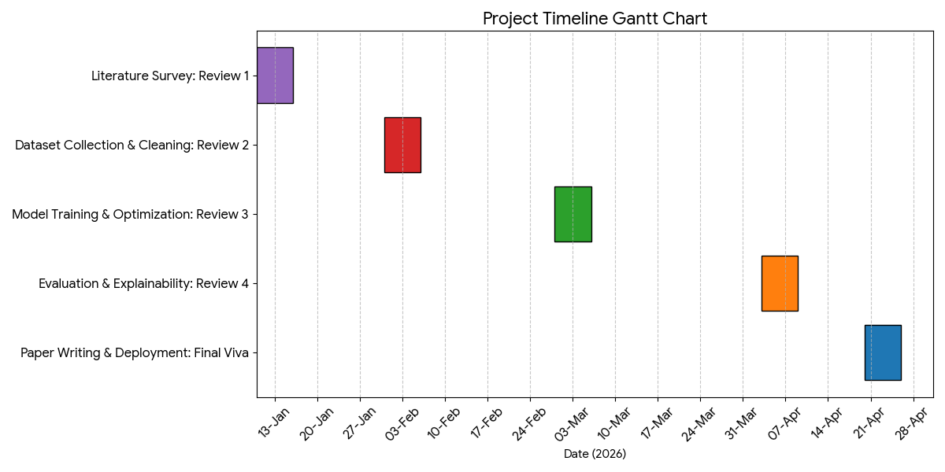
Timeline of the Project (Gantt Chart)

Slide 13
References (IEEE Paper format)
[1]. S. Kamilaris and F. X. Prenafeta-Boldú, “Deep learning in agriculture: A survey,” Computers and Electronics in Agriculture, vol. 147, pp. 70–90, Apr. 2018.
[2]. A. Ferentinos, “Deep learning models for plant disease detection and diagnosis,” Computers and Electronics in Agriculture, vol. 145, pp. 311–318, Feb. 2018.
[3]. M. A. Z. Raja et al., “Cattle breed classification using deep convolutional neural networks,” IEEE Access, vol. 8, pp. 183051–183060, 2020.
[4]. J. Redmon et al., “You only look once: Unified, real-time object detection,” IEEE CVPR, pp. 779–788, 2016.
[5]. A. Dosovitskiy et al., “An image is worth 16×16 words: Transformers for image recognition at scale,” ICLR, 2021.

Slide 14


